Slide 1


Slide 2
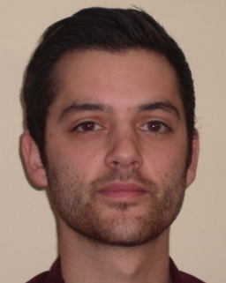
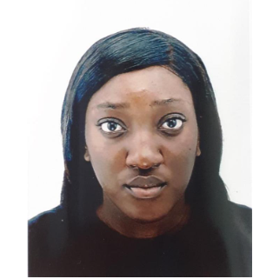
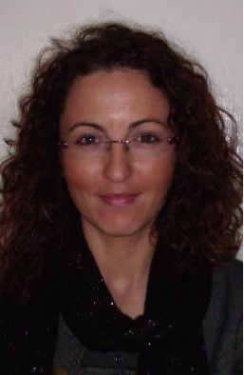
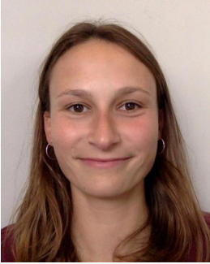
Calvin Fieldhouse Asari Larry-Etah Esin Soufis-Law Grace Milledge -Smith
Pharmacist Pharmacist Pharmacist Health and Wellbeing Coach

Slide 3
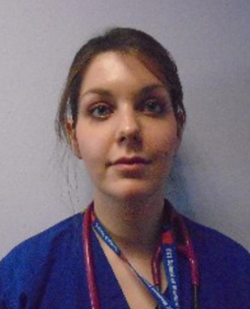
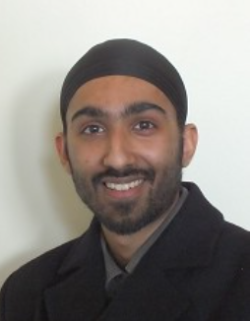
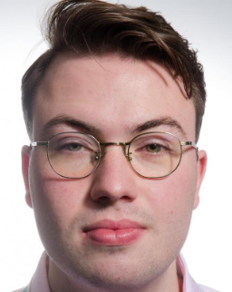
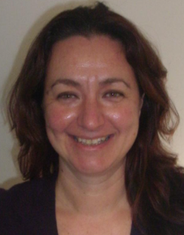
Dr Astrid Harbour Dr Ishmit Moonga Dr Tom Stonehouse Dr Carlie Grindey
F2 Doctor GP F2 Doctor GP

Slide 4
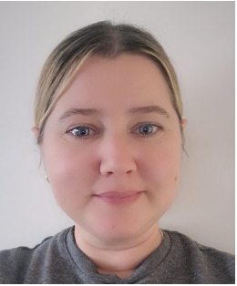
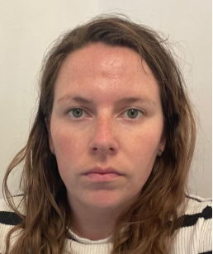
Claire Rowsell Georgie Wells Peers
PCA PCA

